Slide 1
Causal Inference with Graph Neural Networks lecture-13 Course on Graph Neural Networks (Winter Term 20/21)
Christian Medeiros Adriano (christian.adriano@hpi.de) - “Chris”
Sona Ghahremani (sona.ghahremani@hpi.de )
Prof. Dr. Holger Giese (holger.giese@hpi.de)

Slide 2
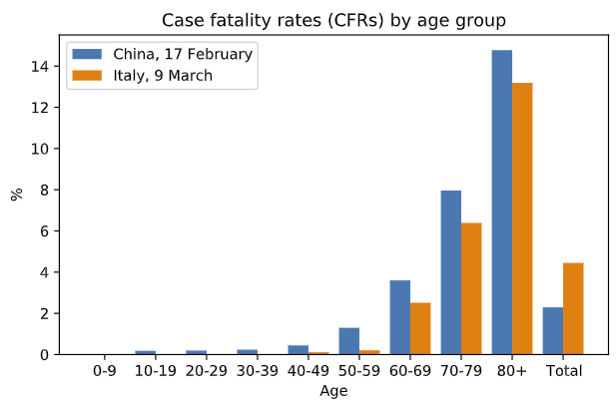
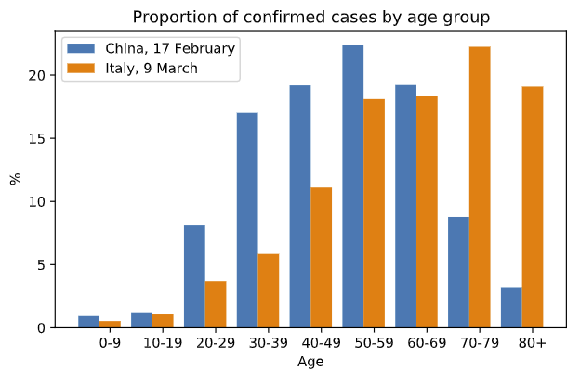
Covid-19 fatality rates China and Italy
Because Italy has a larger proportion of confirmed cases among older age groups.
CFR(China) < CFR(Italy) !
Sources: [Schölkopf et al. 2020] [Wu & McGoogan 2020] [Instituto Superiore di Sanita 2020]
Notes:
how can the disease in Italy be less fatal for the young, less fatal for the old, but more fatal for
the people overall?
[Schölkopf et al. 2020] von Kügelgen, J., Gresele, L., & Schölkopf, B. (2020). Simpson's paradox in Covid-19 case fatality rates: a mediation analysis of age-related causal effects. arXiv preprint arXiv:2005.07180.
[Wu & McGoogan 2020] Zunyou Wu and Jennifer M McGoogan. Characteristics of and important lessons from the
coronavirus disease 2019 (COVID-19) outbreak in China: summary of a report of 72 314
cases from the Chinese Center for Disease Control and Prevention.
Jama, 2020.
[Instituto Superiore di Sanita 2020] Instituto Superiore di Sanita. Epidemia COVID-19: Aggiornamento nazionale, 09 Marzo 2020 – ore 16:00. https://www.epicentro.iss.it/coronavirus/bollettino/Bollettino-sorveglianza-integrata-COVID-19_09-marzo-2020.pdf
, 2020
Quote from [Scholkoepf et al. 2020] “How can such a pattern be explained? The key to understanding the phenomenon lies in the fact
that we are dealing with relative frequencies: the CFRs shown in percent in Fig. 1a are ratios and
correspond to the conditional probabilities of fatality given a case from a particular age group and
country. However, such percentages conceal the absolute numbers of cases within each age group.”

Slide 3
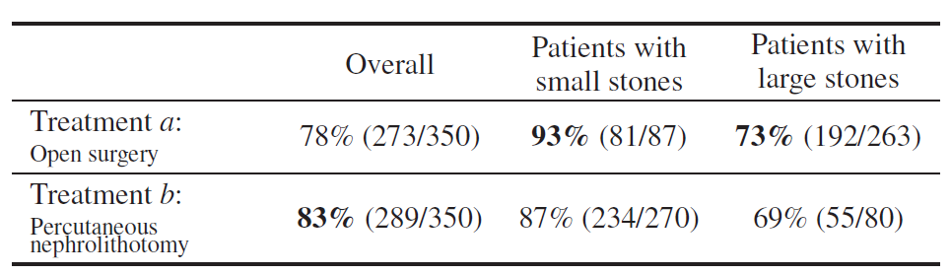
Simpsom Paradox
Definition: this paradox happens when a statistic holds for the entire population, but reverses at each subpopulation
more
more
Source: [Peters et al. 2017] [Bottou et al., 2013, Charig et al., 1986, tables I and II]

Slide 4
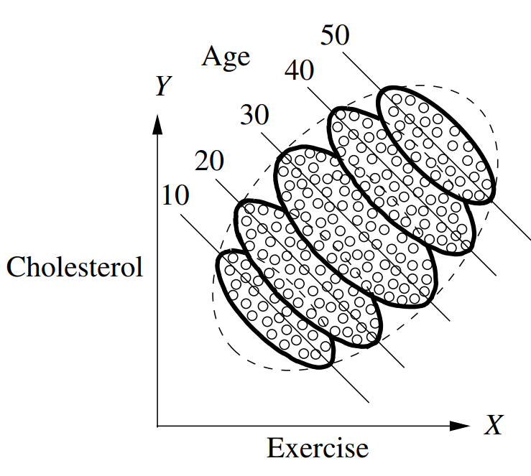
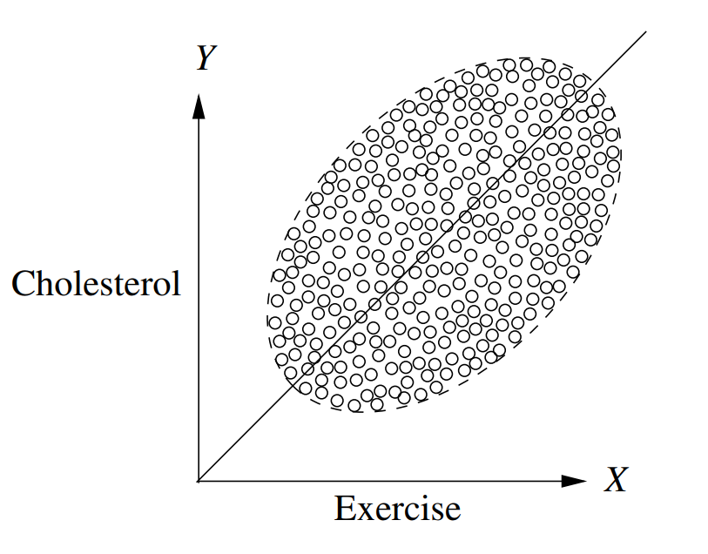
Simpsom Paradox - 2
Source: Pearl, Glymour & Jewell, Causal Inference in Statistics: A Primer, 2016
Solution – condition on additional factors!
Notes:
Another good example is the length of comments on Reddit.
Barbosa, S., Cosley, D., Sharma, A., & Cesar Jr, R. M. (2016, April). Averaging gone wrong: Using time-aware analyses to better understand behavior. In Proceedings of the 25th International Conference on World Wide Web (pp. 829-841). International World Wide Web Conferences Steering Committee.

Slide 5
When to condition? Confounding graph patterns
Fork
Skill
Pipe
Difficulty
Duration
Accuracy
Difficulty
Accuracy
Collider
Descendant
Difficulty
Explanation size
Explanation size
Duration
Skill
Duration
Accuracy
Accuracy

Slide 6
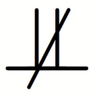
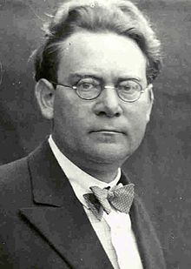
Reichenbach’s Common Cause Principle
Assume that X Y (X and Y are dependent)
X causes Y
Y causes X
There is a third hidden common cause
Combination all the above
In other words, “there is not correlation without causation”
Hans Reichenbach 1891-1953
Notes:
Latex code for the independence symbol - https://tex.stackexchange.com/questions/218631/symbol-for-not-conditionally-independent

Slide 7
How to deconfound?
Condition on the parents (close backdoor paths)
Adjustment formula
parents of X, e.g., programmer skill, complexity of code, buggy/not buggy
outcome, e.g., True Positive
$$P\left(Y=y \right| do\left(X=x\right)= \sum_{z}{P\left(Y=y \right| X=x, Z=z) P\left(Z=z\right) }$$
difficulty low (0) or high (1)
$$P\left(Y=y \right| do\left(X=x\right)= \sum_{z}{\frac{P(Y=y, X=x, Z=z)}{P(X=x, Z=z)} }$$
Propensity Score

Slide 8
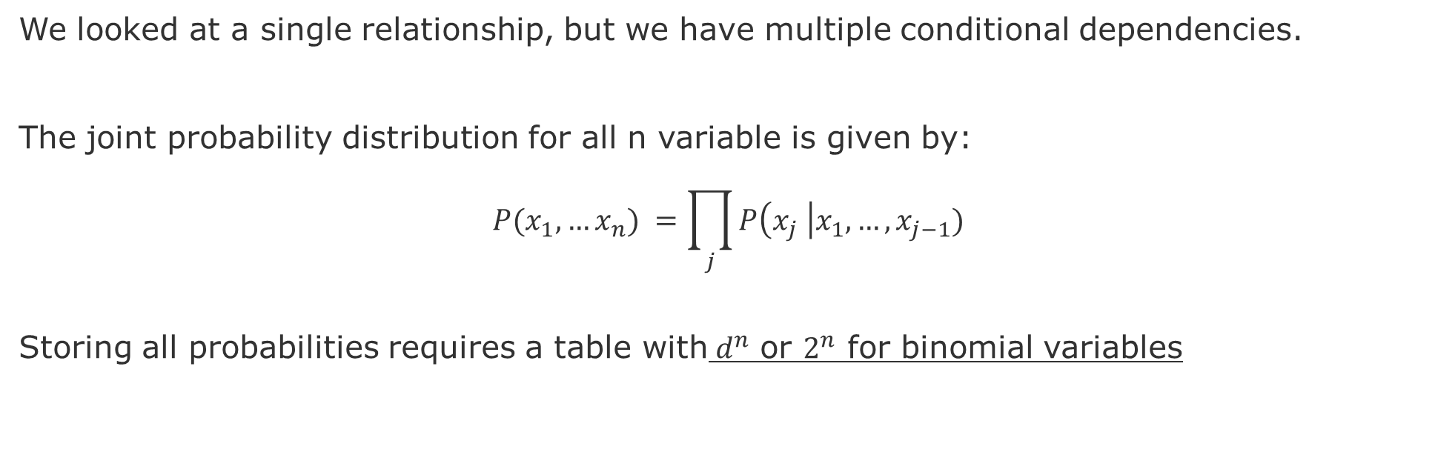
Methodological problem- Context
We looked at a single relationship, but we have multiple conditional dependencies.
The joint probability distribution for all n variable is given by:
$$P(x_{1},…x_{n}) =\prod_{j}{P\left(x_{j} \right|x_{1},…,x_{j−1})}$$
Storing all probabilities requires a table with${ d}^{n}$ or $2^{n}$ for binomial variables
Hence, the exhaustive exploration of all DAGs with n variables is super-exponential in n, hindering the effectivity of brute-force methods for observational causal discovery even for moderate n.
Notes:
Still exponential in the number of parents, but we do not expect too many parents. The reason being that we do not expect that everything is conditional on everything.

Slide 9
Methodological problem-II
Besides being small-world representations, a graph allows for the discover of structural properties of the probability models.
However, the graph of these dependencies still grows very fast
7 nodes = 4 million graphs
8 nodes = 800 billion graphs
9 nodes = 1,548 times more
(or 1.2 10^16 graphs)
Hence, we need to be able to refine a graph model.
But how?
source: [Sloane 2019]
Notes:
Hence, we need to be able to refine a graph model, for that we need a set of operations and properties so we can test hypotheses about graph dependencies and independencies
[Sloane 2019] N. J. A. Sloane, Number of acyclic digraphs (or DAGs) with n labeled nodes, in The Online Encyclopedia of Integer Sequences, available at http://oeis.org/A003024/b003024.txt (accessed May 2019)
However, nodes can be arranged in many different. Three nodes can be arranged in 25 different acyclic graphs (DAG), 4 nodes can compose 543, and 5 nodes 29281 DAGs, 6 nodes 3781503, and 7 to 1138779265 DAG. Yes, but how to know which is the correct mechanism?
7 nodes = 4 million graphs
8 nodes = 800 billion graphs
9 nodes = 1,548 times more (or 1.2 10^16 graphs)

Slide 10
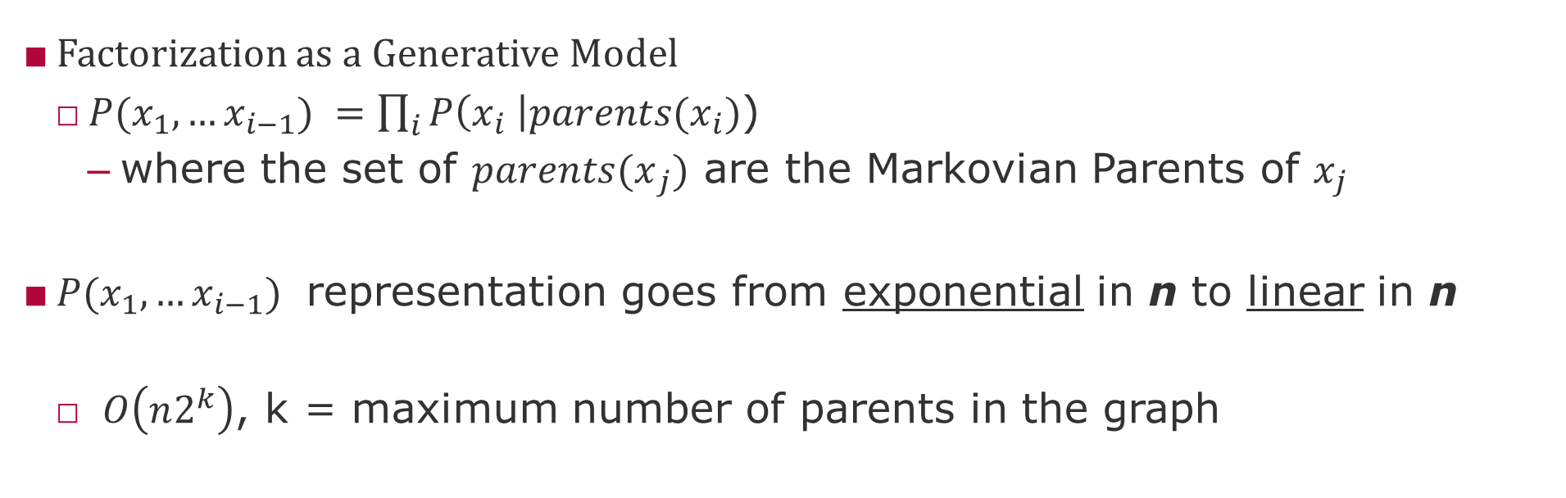
Markovian parents?
Factorization as a Generative Model
$P(x_{1},…x_{i−1}) =\prod_{i}{P\left(x_{i} \right|{parents(x}_{i})}$)
where the set of ${parents(x}_{j})$ are the Markovian Parents of $x_{j}$
$P(x_{1},…x_{i−1})$ representation goes from exponential in n to linear in n
$O\left(n2^{k}\right)$, k = maximum number of parents in the graph
However, this still requires two strong assumptions:
Known structure of the graph (parent-child relationships) and
Small maximum number of parents of any given node.
Notes:
Still exponential in the number of parents, but we do not expect too many parents. The reason being that we do not expect that everything is conditional on everything.
However, we can save space if we know that variables depend on a small set of other variables. Dependency structure allows to decompose large distribution functions into smaller ones that can latter on be combined. A dependency structure is a graph.

Slide 11
Independent Causal Mechanisms (ICM) Principle
“The causal generative process of a system’s variables is composed of autonomous modules that do not inform or influence each other.
In the probabilistic case, this means that the conditional distribution of each variable given its causes (i.e., its mechanism) does not inform or influence the other mechanisms.”
Schölkopf, B. (2019). Causality for machine learning. arXiv preprint arXiv:1911.10500.
Notes:
This principle subsumes several notions important to causality, including separate intervenability of causal variables,
modularity and autonomy of subsystems, and invariance (Pearl, 2009a; Peters et al., 2017). If we have only two variables,
it reduces to an independence between the cause distribution and the mechanism producing the effect distribution.

Slide 12
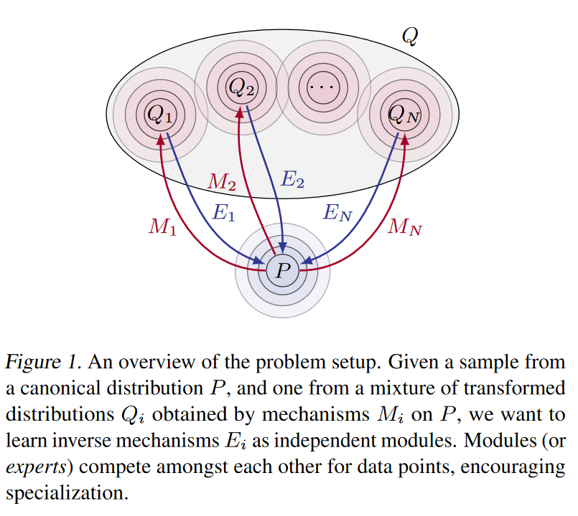
Locality of Mechanisms
Knowledge can be decomposed in modules and mechanisms that are independent
Mechanisms can only be discovered by interventions, i.e., acting in the world
Mechanisms can be reuse across subdomains
Interventions usually affect only one mechanism at a time
There is only one causal graph that reflects the true causal mechanisms
source: Parascandolo, G., et al., (2018) Learning Independent Causal Mechanisms, PMLR 80.

Slide 13
Causal Inference Concepts

Slide 14
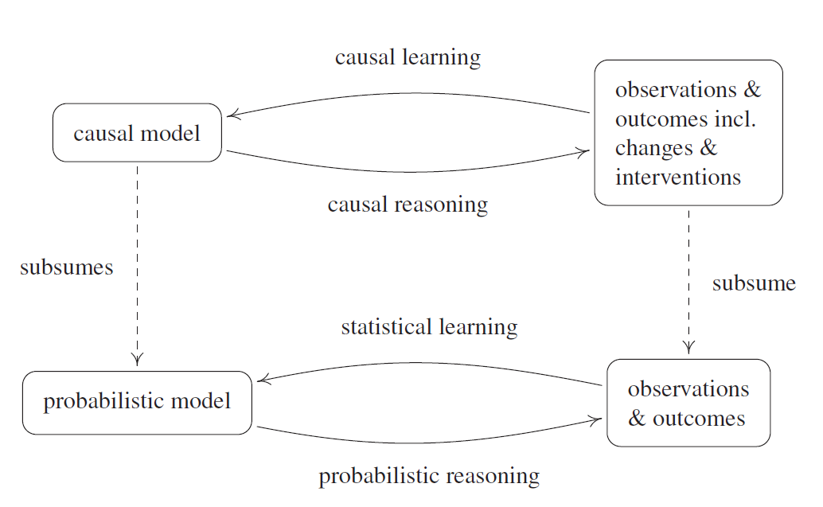
Overall approach to causal inference
source: Peters, J., Janzing, D., & Schölkopf, B. (2017). Elements of Causal Inference: Foundations and Learning Algorithms. MIT Press.
Notes:
@book{peters2017elements, title={Elements of Causal Inference: Foundations and Learning Algorithms}, author={Peters, Jonas and Janzing, Dominik and Sch{\"o}lkopf, Bernhard}, year={2017}, publisher={MIT Press} }

Slide 15
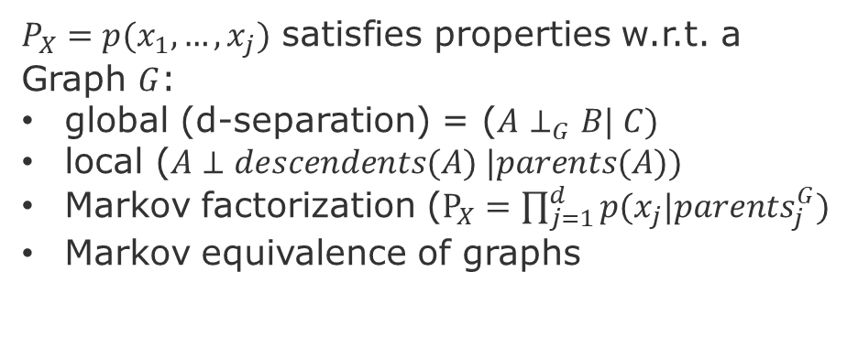
Overview of Causal Inference Methodology
Methods
Fundamental problem of causality
Confounding
Potential outcome
No causation without intervention
Motivation
Ignorability (no confounders)
Positivity (no imbalances)
Modularity (stable unit of treatment)
Consistency (compliance)
Exclusiveness (effective intervention)
Causal discovery
Matching
Adjustments (backdoor criterion)
Hypothetical interventions (do-operator)
Instrumental Variables
Assumptions
$P_{X}=p(x_{1},…,x_{j})$ satisfies properties w.r.t. a Graph $G$:
global (d-separation) = ($A⊥_{G}B| C)$
local ($A⊥descendents(A) |parents(A))$
Markov factorization ($P_{X}=\prod_{j=1}^{d}{p(x_{j}|p{arents}_{j}^{G}})$
Markov equivalence of graphs
Models
Graph-based
Potential outcome-based
Average Treatment Effect (ATE)
Conditional ATE (CATE)
AT on the Treated (ATT)
Local ATE (LATE)
Notes:
Local property can be test

Slide 16
Methodological Problem Statement
How to combine quantitative and qualitative statements about cause and effects?
Quantitative: P(cause) that is independent of P(effect | cause)
Qualitative: Dependencies and independencies between variables
How to test hypotheses about graph dependencies and independencies?
Operations: Deconfounding, Intervention, Counterfactuals
Properties: Modularity, Stability, Ignorability
Notes:
General and fundamental methodological problem:
How to combine quantitative and qualitative statements about cause and effects?
Quantitative: P(cause) that is independent of P(effect | cause)
Qualitative: Dependencies and independencies between variables
This scalability problem breaks down in the problems of operations and properties.
As we have seen before this is a scalability problem. The breaks down in the problems of operations and properties.

Slide 17
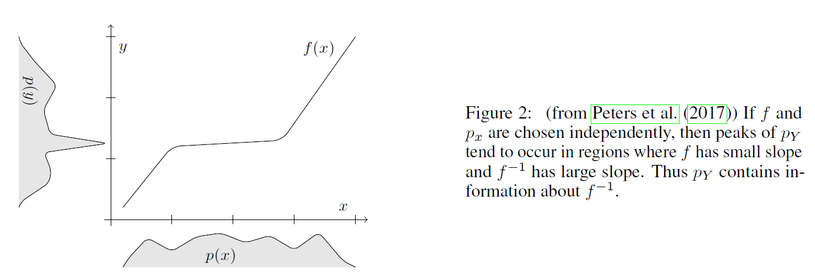
Intervention
Intuition: Interventions allow to maximize mutual information between:
1- intentions (goal-conditioned policies) AND
2- changes in state (trajectories) condition on the current state
Measures of dependence of mechanisms
Peters, D. Janzing, and B. Schölkopf. 2017. Elements of Causal Inference - Foundations and Learning Algorithms. MIT Press, Cambridge, MA, USA.
Schölkopf, B. (2019). Causality for machine learning. arXiv preprint arXiv:1911.10500.

Slide 18
Intervention - Examples
What should I do in the system to change Y?
What treatment should I take to attain a certain level of change on Y?
e.g., increase programmer skill to improve code inspection accuracy?
Should recruit graduate student with minimum four years of experience OR
Give programmers the double of the time to finish a task?
Ask programmers to give a second or third look at the same source code?
Notes:
However, if I only want to predict, then just need to throw all the variables in my favorite model and train it.
Peters, D. Janzing, and B. Schölkopf. 2017. Elements of Causal Inference - Foundations and Learning Algorithms. MIT Press,
Cambridge, MA, USA.

Slide 19
Counterfactual
What would have been the outcome Y if the covariate X had a different value?
e.g., would this programmer have been more accurate if she:
Has spent more time?
Had see the source code for a second and third time?
Hence, has had the chance to increase confident?
Has written a longer explanation?

Slide 20
Modularity of interventions
Definition:
modularity of the interventions consists of two assumptions:
the intervention on node X affects only the structural assignments of X
how the intervention is executed does not influence the results of the intervention
pg. 125 in [Peters, Janzing, & Schölkopf 2017]
Intuition:
We can set and unset variable values without altering the structure of the functions that relate the variables with each other.
Notes:
[Peters, Janzing, & Schölkopf 2017] Peters, J., Janzing, D., & Schölkopf, B. (2017). Elements of causal inference: foundations and learning algorithms. MIT press.

Slide 21
Stability condition
Definition: As we vary the parameters of a causal model (e.g., regression coefficients), no independences in the probability model can be destroyed.
[Pearl 2009]
Intuition:
Causal relationships are more stable than probabilistic relationships, because we assume that
Causal relationships = objective physical constraints in our world (ontological)
Probabilistic relationships = belief or knowledge about the world (epistemic)
Notes:
See page 49 of [Pearl 2009] for an example of how to violate this condition by having unstable dependencies.

Slide 22
Ignorability
Definition:
It is possible to identify or estimate an unbiased result from data that was originated from selection bias, if the following holds:
Y(X) is conditionally independent of X|Z
Intuition:
Conditioning on Z takes away the variation of the individual. This means that the treated (A=1) and the control (A=0) are equivalent in terms the distribution of their covariates.
Notes:
Ignorability (or exchangeability) means that treated (A=1) and control (A=0) are equivalent in terms the distribution of their covariates. Positivity means that propensity score is between zero and one (excluding), but not zero or one. Formal definition ignorability

Slide 23
Fundamental Concepts

Slide 24
Bayesian Networks
Definition: A Bayesian Network (BN) is a Directed Acyclic Graph (DAG) where nodes are propositional variables and edges are local dependencies between conceptual related propositions.
Intuition: Nodes are variables and edges are conditional probabilities.
P(Z)
Z
P(X|Z)
P(Y|Z)
X
Y
P(Y)
P(X)
P(Y|X)

Slide 25
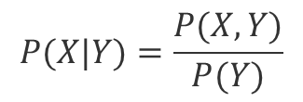
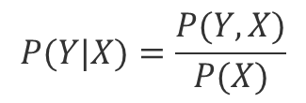
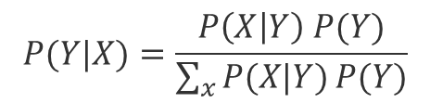
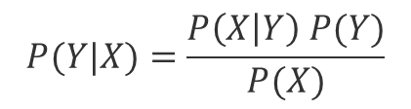
Recap - Conditional probability and Bayes Theorem
$$P(Y|X)=\frac{P(Y,X)}{P(X)}$$
P(Z)
(1)
Z
$$P(X|Y)=\frac{P(X,Y)}{P(Y)}$$
P(X|Z)
P(Y|Z)
(2)
X
Y
$$P(Y|X)=\frac{P\left(X | Y\right) P(Y)}{P(X)}$$
P(Y)
(3)
(Bayes Theorem)
P(X)
P(Y|X)
$$P(Y|X)=\frac{P\left(X | Y\right) P(Y)}{\sum_{x}{P(X|Y)}P(Y)}$$
(4)

Slide 26

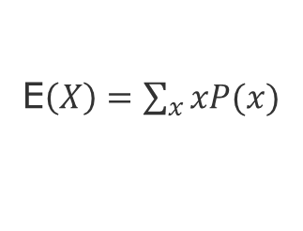
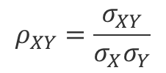
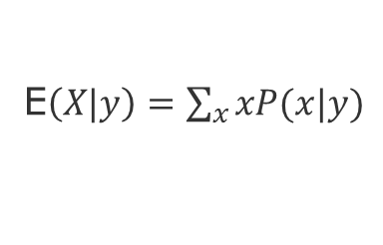

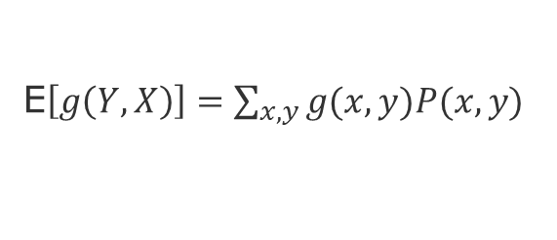
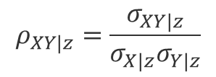
Recap - Conditional Correlation and Regression
P(Z)
(Mean)
E$\left(X\right)=\sum_{x}{xP(x)}$
Z
P(X|Z)
P(Y|Z)
(Conditional Mean)
E$\left(X|y\right)=\sum_{x}{xP(x|y)}$
X
Y
(Expectation of a function)
E$\left[g\left(Y,X\right)\right]=\sum_{x,y}{g(x,y)P(x,y)}$
P(Y)
P(X)
P(Y|X)
(Covariance)
$$g\left(Y,X\right)=σ_{XY}= E[ (X−E(X)) . (Y – E(Y)) ]$$
(Regression)
(Correlation)
$$ρ_{XY}=\frac{σ_{XY}}{σ_{X}σ_{Y}}$$
y$=a+bx$
$$ρ_{XY|z}=\frac{σ_{XY|z}}{σ_{X|z}σ_{Y|z}}$$
${b=R}_{YX|Z}$ $=ρ_{XY|Z}\frac{σ_{X|Z}}{σ_{y|Z}}$
(Conditional Correlation)

Slide 27

Interventional Expectation
$$E[Y| do(X=x)]≠ E[Y | X]$$
Because of the unobserved confounders!

Slide 28
Identifiability
Can I predict the outcome of an intervention?
A causal quantity is identifiable if it can be written as a function of the observed variables.
In other words. If I observe an infinite amount of data from my processes can I make a prediction under intervention?
Can I use the observable joint distribution to make a prediction about some other joint distribution (which is the one that I intervened)?
Notes:
From https://www.youtube.com/watch?v=vKK_1GvaG0Y

Slide 29
From Bayesian Network Methods to Robust ML
Scalability & Stability
Markov Factorization
Reichenbach’s Common Cause Principle
d-Separation
Markov-Blanket
Causal Markov Condition
do-Operator
Back-door criteria
Adjustment
Modularity
Ignorability
Notes:
Important to identify structural properties
(Scalability, Stability of causal relations and independence of random terms)

Slide 30
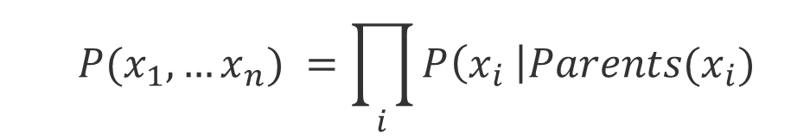
Markov factorization
$$P(x_{1},…x_{n}) =\prod_{i}{P\left(x_{i} \right|{Parents(x}_{i})}$$
Causal Markov kernels
If P admits the factorization relative to a DAG G, we can say that the DAG represents the probability function P, i.e., G and P are compatible or that P is Markov relative to G.
We can also say that the Graph G induces the probability P.

Slide 31
d-separation
X and Y are d-separated if all paths between X and Y are blocked by a set Z of nodes,
i.e., X ꓕ Y | Z
The blocking* situations are:
X
Z
Y
Pipe
X
Z
Y
Blocked only if conditioned on Z
X
Z
Y
Fork
X
Z
Y
Already blocked without conditioning on Z
Collider
*grey means blocked (usually by conditioning on it)
Notes:
Colliders, or Immoralities or v-structures

Slide 32
Consequences of d-Separation

Slide 33
Causal Markov Condition
Definition:
P is Markov w.r.t. G for all Z, if X is d-separated of Y given Z, i.e., X ꓕ Y | Z [Peters, Janzing & Schölkopf 2017]
Hence, for all distinct variables X and Y in G ,if X does not cause Y, then
P(X | Y , Parents(X)) == P(X | Parents(X)) [Hausman & Woodward 1999]
Intuition:
Conditional on its parents, X is independent of every variable in G except its effects [Spirtes, Glymour & Scheines 1993]
Notes:
Causal Markov Condition relates statements about graph separation to conditional independences.
Note however, that different graphs can encode the same conditional independences.
https://en.wikipedia.org/wiki/Causal_Markov_condition
[Peters, Janzing & Schölkopf 2017] Peters, J., Janzing, D., & Schölkopf, B. (2017). Elements of causal inference: foundations and learning algorithms. MIT press.
[Hausman & Woodward 1999] Hausman, D. M., & Woodward, J. (1999). Independence, invariance and the causal Markov condition. The British journal for the philosophy of science, 50(4), 521-583.
[Spirtes, Glymour & Scheines 1993] Spirtes, Peter, Glymour, Clark and Scheines, Richard [1993]:Causation, Prediction,and Search,New York: Springer-Verlag.

Slide 34
Markov Blanket [Pearl 1988]
Definition: A Markov Blanket of X consists of all Parents(X), Descendants(X), and Co-Parents(X)
Intuition: A node is conditionally independent of the entire network, given its Markov blanket.
Notes:
Causal Markov Condition relates statements about graph separation to conditional independences.
Note however, that different graphs can encode the same conditional independences.
https://en.wikipedia.org/wiki/Causal_Markov_condition
[Hausman & Woodward 1999] Hausman, D. M., & Woodward, J. (1999). Independence, invariance and the causal Markov condition. The British journal for the philosophy of science, 50(4), 521-583.

Slide 35
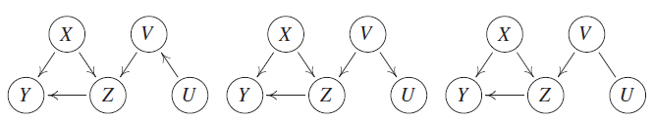
Markov equivalence classes
Graphs are equivalent if they have the same set of nodes and present the same colliders.
source: [Peters, Janzing & Schölkopf 2017]
Notes:
Causal Markov Condition relates statements about graph separation to conditional independences.
Note however, that different graphs can encode the same conditional independences.
https://en.wikipedia.org/wiki/Causal_Markov_condition
[Peters, Janzing & Schölkopf 2017] Peters, J., Janzing, D., & Schölkopf, B. (2017). Elements of causal inference: foundations and learning algorithms. MIT press.
[Hausman & Woodward 1999] Hausman, D. M., & Woodward, J. (1999). Independence, invariance and the causal Markov condition. The British journal for the philosophy of science, 50(4), 521-583.

Slide 36
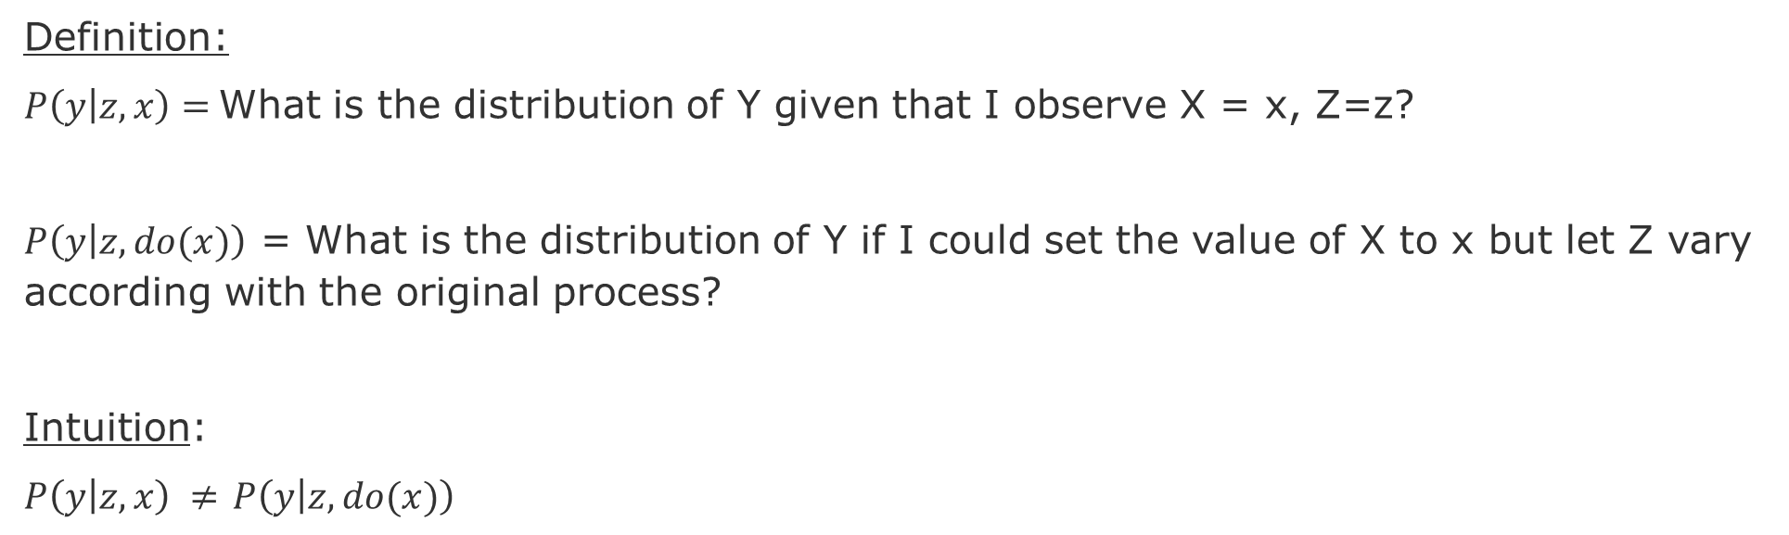
do-Operator
Definition:
$P\left(y | z,x\right)=$What is the distribution of Y given that I observe X = x, Z=z?
$P\left(y | z,do(x)\right)$ = What is the distribution of Y if I could set the value of X to x but let Z vary according with the original process?
Intuition:
$P\left(y | z,x\right) ≠$ $P\left(y | z,do(x)\right)$
(Original)
(After intervention)
Z
Z
P(X|Z)
P(Y|Z)
P(Y|Z)
X
Y
X
Y

Slide 37
Back-door criterion
Definition: A set of variables Z satisfies the back-door criteion relative to X,Y if no node in Z is a descendant of X, and Z blocks every path between X and Y that contains an arrow into X.
Then the causal effect of X on Y is given by:
$$P\left(Y=y \right| do\left(X=x\right)= \sum_{z}{P\left(Y=y \right| X=x, Z=z) P\left(Z=z\right) }$$

Slide 38
Back-door criterion - Intuition
Intution:
We want to block back-door paths because they make X and Y dependent.
However, we do not want to block any descendants of X because they might mediate causal effect from X to Y.
We do not want to create spurious paths, e.g., by conditioning on a colliders that creates a spurious dependency between and X and Y.
Since these dependencies are not causal, they are confounders.
Back-door criterion enables to attain the ignorability condition, hence mitigate selection bias [Morgan & Winship 2015].

Slide 39
Causality in Machine Learning

Slide 40
Need for Principled Design in Machine Learning
Most machine learning work essentially tries to skip the opening steps, tackling complex problems empirically, without ever trying to build affirm understanding about what initial primitive sare really required for language and higher-level cognition.
Skipping those first steps has not gotten us thus far to language understanding and reliable trustworthy systems that can cope with the unexpected; it is time to reconsider.
Gary Markus (2020), The Next Decade in AI: Four Steps Towards Robust Artificial Intelligence
Notes:
https://www.quora.com/What-is-Yoshua-Bengios-new-Consciousness-Prior-paper-about

Slide 41
Why do we need Causality in Machine Learning?
Context: Correlation-based models make four strong assumptions
Out Of Distribution (OOD)
Covariate Shift and Concept Drift (non-stationarity)
Independent and Identically Distributed (IID) data
Scrambling Training and Testing data
Lack of guidance to intervention (control and exploration)
Credit assignment (explanation, counterfactual thinking)
Search through possible futures is highly intractable
Impact:
Limits systematic generalization
High complexity for adaptation
Yoshua Bengio: From System 1 Deep Learning to System 2 Deep Learning (NeurIPS 2019)
Notes:
Schölkopf, B, et al. (2012). On causal and anticausal learning. arXiv preprint arXiv:1206.6471
Schölkopf, B. (2019). Causality for machine learning. arXiv preprint arXiv:1911.10500.
Parascandolo, G., et al., (2018) Learning Independent Causal Mechanisms, PMLR 80.
Learning theory supports generalization only within same distribution
localized change assumption – Scholkopf 2012
On causal and anticausal learning
Meta-Learning
Right decomposition of knowledge
Meta-randsfer Object for learning to disentangle Causal Mechanisms
Right way to factorize the join-distribution
How to get out of distribution (OOD) transfer/generalization?
Good representations of variables, mechanisms and localized changed hypothesis
OOD generalization as training objective
This depends on good decomposition and knowledge representation
Good OOD performance is a good training signal for factorizing knolwedge

Slide 42
Solutions to generalization shortcomings
Understand how distributions change (simulate non-stationary and dynamic processes)
Composable local representations
Deep nets layers
Factorization of Joint Probabilities
Sparse factor graphs
Alternative assumptions (causal mechanisms) to the I.I.D. assumption
Independence of mechanism principle
Identify knowledge (rules) that can be reused
meta-learning and transfer learning
Temporal Causal Mechanisms
Explanations only for short sequences
Schölkopf, B. (2019). Causality for machine learning. arXiv preprint arXiv:1911.10500.

Slide 43
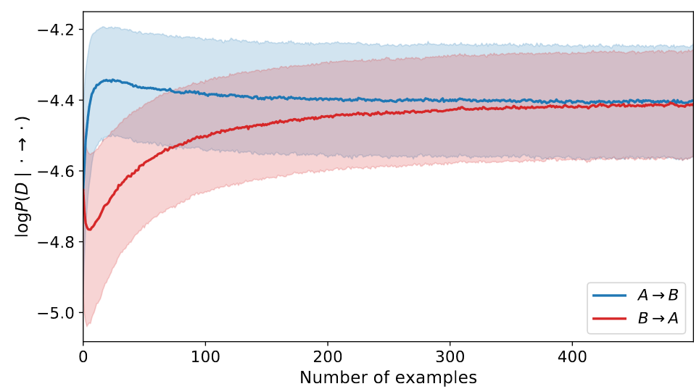
Causal Neural Networks
Causal Generative Neural Networks [Goudet et al. 2017]
CGNNs are causal models of the world that are able to simulate the outcome of interventions to discover v-structures and causal-effect relationships.
Meta-Transfer Objective for Learning to Disentangle Causal Mechanisms [Bengio et al. 2019]
Factorizes a Joint Distribution by using OOD. The learner that has the right factorization will adapt much faster (i.e., require less data). Adapt consists to recover to a change in the distribution.
A causes B or vice versa? How to disentangle (A,B) from observed (X,Y)
Approach: Exploit changes in the distribution AND Speed of adaption
A
B
X
Y
Goudet, O., et al., (2017), Causal Generative Neural Networks.
Bengio, Y., et al. (2019), A meta-transfer objective for learning to disentangle causal mechanisms.
Notes:
Goudet, et al., 2017, Causal Generative Neural Networks

Slide 44
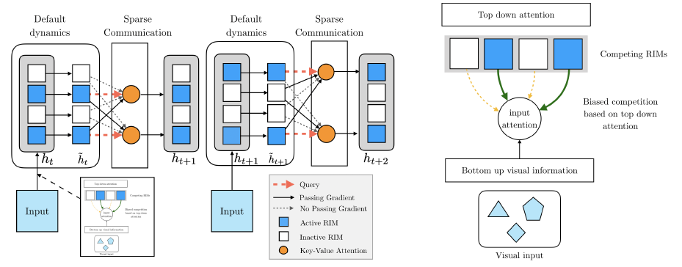
Recurrent Independent Mechanisms [Goyal et al. 2020]
Goal: learn modular structures that (1) reflect the dynamics of the environment and (2) better generalizes, i.e., is more robustness to changes on few of the underlying causes. Approach: Modularize the computation.
source: [Goyal et al. 2020]
first stage, individual RIMs produce a query which is used to read from the current input
second stage, an attention-based competition mechanism is used to select which RIMs to activate (right figure) based on encoded visual input (blue RIMs are active, based on an attention score, white RIMs remain inactive)
third stage, individual activated RIMs follow their own default transition dynamics while non-activated RIMs remain unchanged
fourth stage, the RIMs
sparsely communicate information between themselves, also using key-value attention.

Slide 45
Quick recap – Where are we now?
Graph Metrics and Random Models
Graph Classification - Clustering
Graph Sampling - Random Walks
Graph Embeddings - Message Passing
PageRank
Graph Structure Learning
Graph Convolutional Networks
Graph Attention Networks
Graph Evolution Networks
Temporal Graph Networks
Graph Neural Differential Equations
Deep Graph Generative Models
Causal Inference with Graph Neural Networks
Network Effects, Cascading and Contagion
Outbreak Detection in Networks
Influence Maximization in Networks
Design concerns
Understand a phenomenon
Extract features
Stablish baselines
Preprocessing data
Description models
Predict an outcome
ML architecture and pipeline
Training models
Evaluation models
Prediction models
Effects of interventions
Risks of confounding
Causal structure
Intervention models
Notes:
[Wang & Tax 2016] Wang, Feng, and David MJ Tax. "Survey on the attention based RNN model and its applications in computer vision." arXiv preprint arXiv:1601.06823 (2016).
[Luong et al. 2015] Luong, Minh-Thang, Hieu Pham, and Christopher D. Manning. "Effective approaches to attention-based neural machine translation." arXiv preprint arXiv:1508.04025 (2015).
[Vaswani et al. 2017] Vaswani, A., Shazeer, N., Parmar, N., Uszkoreit, J., Jones, L., Gomez, A. N., ... & Polosukhin, I. (2017). Attention is all you need. Advances in neural information processing systems, 30, 5998-6008.
Bahdanau, Dzmitry, Kyunghyun Cho, and Yoshua Bengio. "Neural machine translation by jointly learning to align and translate." arXiv preprint arXiv:1409.0473 (2014).
Xu, Kelvin, et al. "Show, attend and tell: Neural image caption generation with visual attention." International conference on machine learning. 2015.
The research described in the paper Graph Convolutional Network (GCN), indicates that combining local graph structure and node-level features produces good performance on node classification tasks. However, the way GCN aggregates is structure-dependent, which can hurt its generalizability.
One workaround is to simply average over all neighbor node features as described in the research paper GraphSAGE. However, Graph Attention Network proposes a different type of aggregation. GAN uses weighting neighbor features with feature dependent and structure-free normalization, in the style of attention.

Slide 46
END

